Slide 1
MACHINE LEARNING APPROACH FOR DETECTING GENE-DISEASE ASSOCIATION
Md. Al-Amin
Md. Shafayat Jamil
Arittra Das
Swarnajit Saha
190104001
190104022
190104083
190104086
Supervised By:
Dr. S.M.A. Al-Mamun
Professor, CSE
Ahsanullah University of Science and Technology

Slide 2
Objective
01
02
03
04
Identify complex relationships of genes and diseases
Find more efficient and cost-effective way
Find potential to improve the diagnosis, treatment, and prevention of diseases
Predict unknown gene associated with disease

Slide 3
Motivation
Find out the approach to discover new treatments for diseases
Bring out improvements in the fields of medicine
Improve the health and well-being of people all across the world
Understand the underlying biological mechanisms of a disease
Enhance treatment success through timely detection

Slide 4
Machine Learning
Analyze large datasets of genetic and clinical data to identify patterns
Provide a better knowledge of the mechanisms by which genes create diseases

Slide 5
Gene
Located on Chromosomes
Physical and functional unit of heredity
Contains the instructions for an organism

Slide 6
Disease
Abnormal Condition
Physical Changes
Permanent or Temporary
Genetic and non-genetic sources

Slide 7
Relation Between Gene&Disease
Gene exist in every cell
Modifications to genes can result in diseases
Examples Cystic fibrosis, Parkinson’s, Autism spectrum disorders, Thalassemia, Hemophilia

Slide 8
Genetic Modification
Mutations
Recombination
Epigenetic Modifications
Gene Environment Interaction
Polygenic Inheritance

Slide 9
Literature Review
“Analysis for Disease Gene Association Using Machine Learning”[1]
Data Collection : DisGeNET, Uniprot, HPRD, CORUM
Diseases : Thalassemia, Diabetes, Malaria, and Asthma
Models : Random Forest ,Naive Bayes,DELM, Classification via clustering and Classification via Regression
Result : Precision up to 93.8%, Recall up to 93.1%, and F- measure up to 92.9%

Slide 10
Literature Review(cont.)
“Machine learning-based approaches for disease gene prediction” [2]
Data Collection : OMIM and PPI
Two unaries, Three semi-supervised and , Five conventional binary classification techniques
Models :SVM, Graph-based SSL,ANN,DT, k-NN, NB etc.
Result : ANN was the best classifier and SVM was the worst

Slide 11
Literature Review(cont.)
“Identifying disease genes using machine learning and gene functional similarities, assessed through Gene Ontology”[3]
Data Collection : SFARI
Disease : Autism Spectrum Disorder
Models : Decision Tree, Random Forest ,Naive Bayes, Linear and Radial SVM
Result : Random Forest up to 80%

Slide 12
Literature Summary
Classification Task
Protein-Protein Interaction and Disease Symptoms
Limited Dataset Size
Combination of Machine Learning and Deep Learning Models

Slide 13
Our Goal
Find the relationship between Gene and Disease
Predict the relationship score
Use machine learning
Predict the score even if the relationship is not in literature

Slide 14
Workflow
Dataset
Data Collection
Data Pre Processing
Features Selection
MAE
MSE
Trained Models
Machine Learning Models
Training
(70%)
Data Partitioning
RMSE
Testing
Testing
(30%)
R^2
MAPE

Slide 15
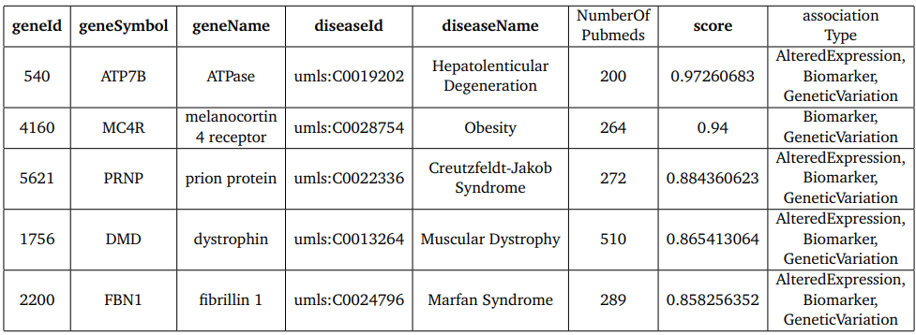
Collected Dataset
Collected from DisGeNET
Total 26523 combinations of gene-disease relations
Table 1 : Collected Dataset [4]

Slide 16
Dataset Description
Gene ID
Gene Symbol
Gene Name
Disease ID
Disease Name
Association Type
Number of Pubmeds
Score

Slide 17
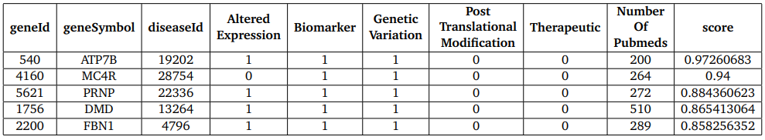
Data Pre-Processing
Separation of the association type
Defined by 0/1
Table 2: Separation of association Type.

Slide 18
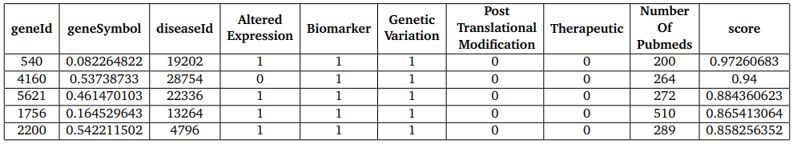
Data Pre Processing(Cont.)
Conversion of gene symbol string to numerical Value
Table 3: Final Input.

Slide 19
Implementation
Traditional Algorithms
Linear Regression
Decision Tree
Random Forest
SVR
KNN

Slide 20
Implementation(cont.)
Boosting Algorithms
Gradient Boost
XG Boost
Cat Boost

Slide 21
Result
Model | MSE | RMSE | MAE | R-squared | MAPE
Linear Regression | 0.0088 | 0.094 | 0.156 | 0.373 | 19.3
Decision Tree | 0.008 | 0.094 | 0.0895 | 0.376 | 10.5
Random Forest | 0.003 | 0.07 | 0.031 | 0.81 | 9.31
Gradient Boosting | 0.003 | 0.07 | 0.036 | 0.74 | 11.10
SVR | 0.010 | 0.10 | 0.08 | 0.30 | 35.76
KNN | 0.006 | 0.081 | 0.135 | 0.537 | 10.71
XGBoost | 0.005 | 0.0721 | 0.0498 | 0.633 | 10.24
CatBoost | 0.005 | 0.0722 | 0.0474 | 0.63 | 10.51
Table 4: Result of Regression Models with score ≥ 0.25.

Slide 22
Result(cont.)
Model | MSE | RMSE | MAE | R-squared | MAPE
Linear Regression | 0.014 | 0.118 | 0.095 | 0.30 | 20.10
Decision Tree | 0.021 | 0.144 | 0.092 | 0.033 | 18.84
Random Forest | 0.012 | 0.107 | 0.076 | 0.429 | 15.60
Gradient Boosting | 0.011 | 0.107 | 0.082 | 0.432 | 17.08
SVR | 0.015 | 0.122 | 0.1 | 0.267 | 21.47
KNN | 0.014 | 0.12 | 0.085 | 0.291 | 17.48
XGBoost | 0.011 | 0.107 | 0.079 | 0.437 | 16.43
CatBoost | 0.011 | 0.106 | 0.080 | 0.443 | 16.70
Table 5: Result of Regression Models with score ≥ 0.30.

Slide 23
Result(cont.)
Model | MSE | RMSE | MAE | R-squared | MAPE
Linear Regression | 0.013 | 0.115 | 0.095 | 0.16 | 18.01
Decision Tree | 0.021 | 0.147 | 0.1 | 0.368 | 18.32
Random Forest | 0.012 | 0.109 | 0.083 | 0.247 | 15.58
Gradient Boosting | 0.012 | 0.109 | 0.088 | 0.251 | 16.74
SVR | 0.015 | 0.122 | 0.105 | 0.059 | 19.20
KNN | 0.015 | 0.121 | 0.092 | 0.070 | 17.26
XGBoost | 0.012 | 0.110 | 0.087 | 0.223 | 16.63
CatBoost | 0.012 | 0.110 | 0.088 | 0.226 | 16.77
Table 6: Result of Regression Models with score ≥ 0.35.

Slide 24
Result(cont.)
Model | MSE | RMSE | MAE | R-squared | MAPE
Linear Regression | 0.011 | 0.107 | 0.088 | 0.229 | 16.98
Decision Tree | 0.019 | 0.139 | 0.094 | 0.31 | 17.47
Random Forest | 0.011 | 0.105 | 0.08 | 0.247 | 15.24
Gradient Boosting | 0.011 | 0.103 | 0.083 | 0.282 | 16.02
SVR | 0.013 | 0.115 | 0.103 | 0.104 | 19.56
KNN | 0.013 | 0.113 | 0.087 | 0.132 | 16.63
XGBoost | 0.011 | 0.106 | 0.084 | 0.244 | 16.05
CatBoost | 0.011 | 0.106 | 0.084 | 0.241 | 16.20
Table 7: Result of Regression Models with score ≥ 0.40.

Slide 25
Result Evaluation
Boosting algorithms exhibit strong overall performance
Consistently Low Error Rates Across Data Segments
Random Forest achieved 81% for score ≥ 0.25
Gradient Boosting achieved 74% for score ≥ 0.25
Low Data Quantity Effect the Models

Slide 26
Future Work
Deploy Advanced Feature-Rich Datasets
Empowering Regression Tasks with Advanced ML and DL Algorithms
Exploring Protein Interactions to Uncover Gene-Disease Relationships

Slide 27
Conclusion
Improving gene-disease correlations
Simplifying representation between gene-disease
Evaluating Performance Across ML Models

Slide 28
References
M. Sikandar, R. Sohail, Y. Saeed, A. Zeb, M. Zareei, M. A. Khan, A. Khan, A. Aldosary, and E. M. Mohamed, “Analysis for disease gene association using machine learning,” IEEE Access, vol. 8, pp. 160616–160626, 2020.
D.-H. Le, “Machine learning-based approaches for disease gene prediction,” Briefings in functional genomics, vol. 19, no. 5-6, pp. 350–363, 2020.
M. Asif, H. F. Martiniano, A. M. Vicente, and F. M. Couto, “Identifying disease genes using machine learning and gene functional similarities, assessed through gene ontology,” PloS one, vol. 13, no. 12, p. e0208626, 20.
“Disgenet.” https://www.disgenet.org/. Accessed on May 12, 2023.

Slide 29
THANK YOU!

